Slide 1
A student sees the following circuit in their physics textbook.
R₁
R₂
R₃
R₄
Construct a mathematical representation that best matches the above circuit.
Which one of the following mathematical representations best matches the above circuit?
V_{total} = I R₁ + I R₂ + I / R₃ + I / R₄
V_{total} = I R₁ + I R₂ + I R₃ + I R₄
V_{total} = I R₁ + I R₂ + (I/2) (1/ R₃ + 1/ R₄)
V_{total} = I R₁ + I R₂ + I (1/R₃ + 1/R₄)⁻¹

Slide 2
A circuit is described by the following mathematical representation:
V_{total} = I R₁ + I [(1/(R₃ + R₂) + 1/ R₄)]⁻¹
Write out a verbal description to match the above representation.
Which verbal description best matches the above representation?
The first resistor is in series while the other three are in parallel.
Resistors two and three are connected in parallel to each other. They are then connected in series to resistor four. This combination is in series to resistor one.
Resistors two and three are connected in series to each other. They are connected in parallel to resistor four. This combination is in series with resistor one.

Slide 3
A 9 volt emf source is connected into a circuit.
I
Which one of the following graphical representations best match the above description for a flow of current over time?
Construct a graphical representation that best matches the above description for a flow of current over time.
1
2
Ι
Ι
t
t
3
4
Ι
Ι
t
t

Slide 4
Suzy is studying her circuits and comes across the following passage:
“We know that the 1st and 4th resistors in a circuit have the same amount of current flowing through them and the other resistors have a different value of current flowing through them.”
Which one of the following circuits below best match the description Suzy just read?
Construct a circuit that best matches the description Suzy just read.
R₂
R₄
2
R₁
R₂
R₃
1
R₁
R₃
R₄
R₂
3
R₁
R₄
4
R₁
R₂
R₃
R₃
R₄
5 No circuit shown matches the above description

Slide 5
A schematic of a circuit is seen below:
1Ω
b
9V
c
a
5Ω
d
3V
Which voltage versus position graph best matches the circuit?
Construct a voltage versus position graph to best match the circuit.
1
2
ΔV
ΔV
a
b
c
d
x
a
b
c
d
x
3
4
ΔV
ΔV
a
b
c
d
x
a
b
c
d
x

Slide 6
Stephen is hooking up his light bulbs. The flow of current through two of the three bulbs is the same while a different amount of current flows through a third. All bulbs have the same resistance.
Which of the circuits below best match the above verbal description.
Construct a circuit to match the above verbal description.
1
2
3
4
5
2 & 3
1 & 4
1, 4 & 5

Slide 7
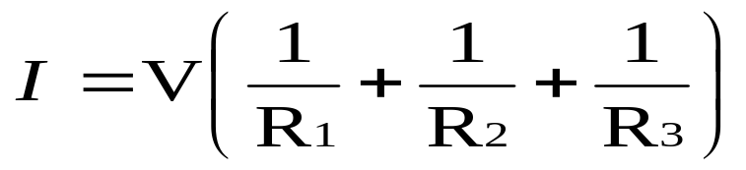

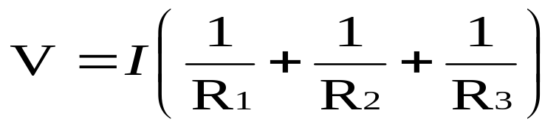
John sees the following circuit in his textbook.
R₁
R₂
R₃
Which of the mathematical representations below best match the above diagram?
Construct a mathematical representation to best match the above diagram.
1
2
3

Slide 8
A picture of a basic flash light (wire and batteries of negligible resistance) is shown below.
Which circuit best matches the above picture?
Construct a circuit to match the above picture.
1
2
3
4
5 No circuit matches the picture.

Slide 9
Old holiday lights are bad because if one goes out they all go out.
Which circuit below best matches the above picture and description?
Construct a circuit to match the above picture and description.
1
2
3
4
5 2 & 4 are both possible choices

Slide 10
New holiday lights are nice in that if only one goes out, the others remain lit.
Which circuit below best matches the above picture and description?
Construct a circuit to match the above picture and description.
1
2
3
4
5 2 & 3 are possible
6 2, 3 & 4 are possible

